Slide 1


Slide 2
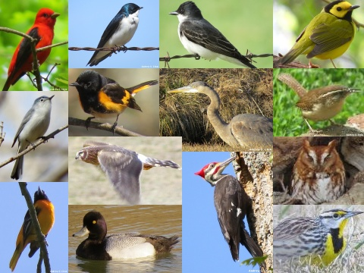
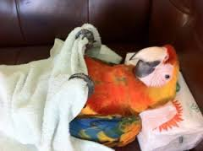
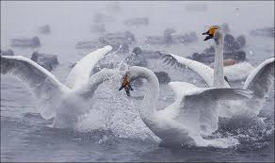
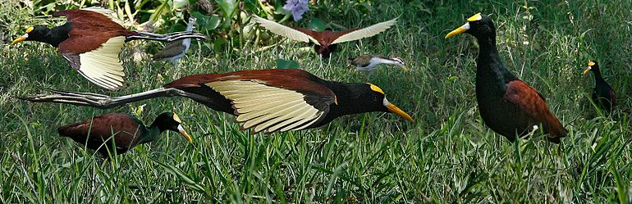
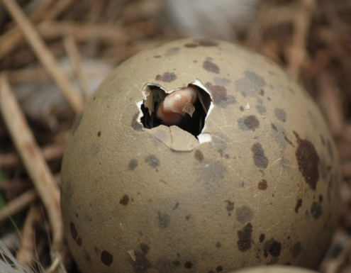
BIRDS
MAIN TOPIC

Slide 3
SUB- TOPICS
COLOR PIGMENTATION
ULTRAVIOLET FEATURES
PET & WILD BIRDS
FLIGHT & FLIGHTLESS BIRDS
REPRODUCTION
ADAPTATION IN BIRDS

Slide 4
COLOUR PIGMENTATION
BY
SYEDA TOOBA ZAINAB

Slide 5
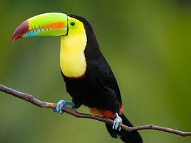
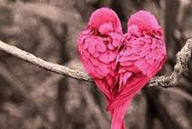
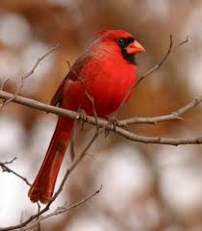
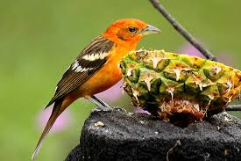
INTRODUCTION
Biological pigments are also known simply as pigments & biochromes
They are substance produced by living organisms that have a colorful resulting from selective colorful absorption.
Biological pigments includes plant pigments and colorful pigments in birds

Slide 6
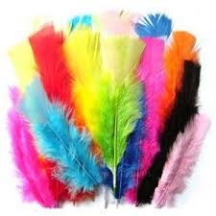
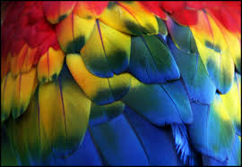
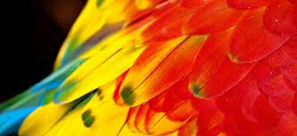
HOW BIRD’S FEATHERS ARE COLOURFUL??
Amazing diversity of colors and patterns exhibited by more than 9000 bird species found in the world.
The colors in the feathers of birds are formed in two different ways :
i. pigments
ii. light refraction.

Slide 7
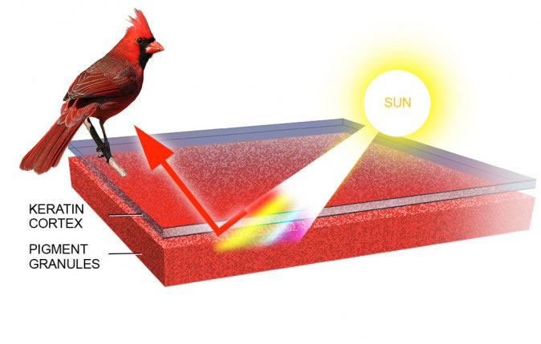
PIGMENTATION
Pigments are colored substance that can be found in both plants and birds.
The coloration created by pigments is independent of the structure of the feathers.
Pigment colorization in birds comes from 3 different groups: carotenoids, melanins, porphyrines.

Slide 8
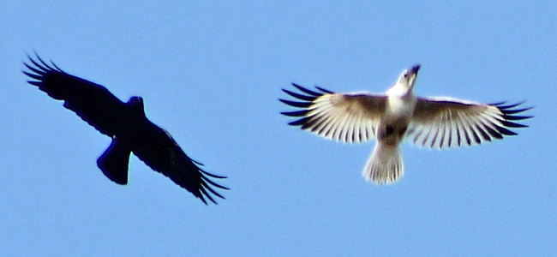
Color abnormalities
When pigments are present (or absent) at unusual levels the appearance of a bird can change dramatically.
Color abnormalities , while not common, do occur on a regular basis.
Few are the examples of birds that commonly show aberrant white patches:
caned goose, American crow, Black-capped, Chickadee, Dark-eyed junco, Common grackle and House sparrow.

Slide 9
Ultraviolet feathers
BY
HAFIZA ROHMA ABID

Slide 10
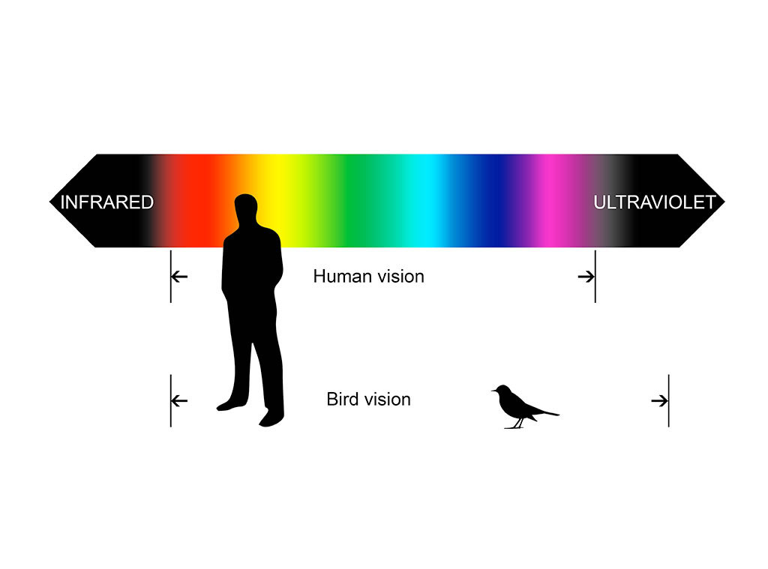
The feather structure of many species also reflect light in the ultraviolet range, because many birds can discriminate a greater variety of colors than humans, including ultraviolet wavelengths, they can appear quite different to each other

Slide 11
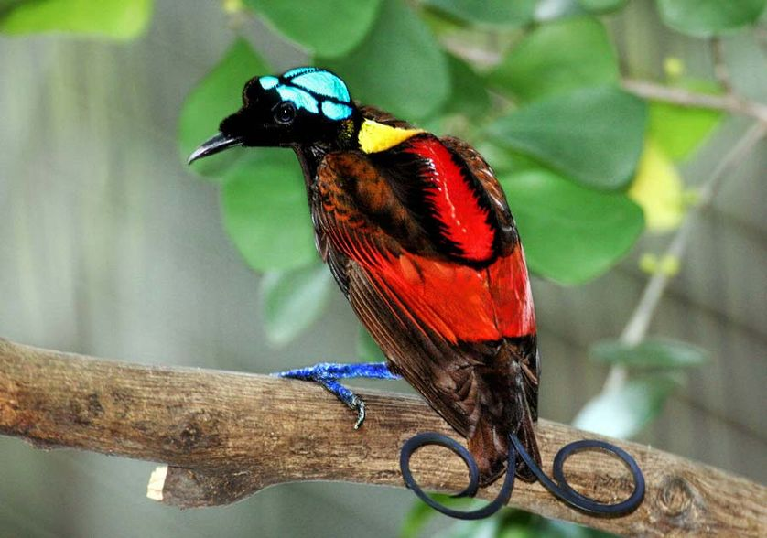
Colorfull feathers
Some of birds are given below which have colorful feathers.
i: Wilson’s bird-of-paradise, ii: Albatross, iii: Booby.
Wilson’s Bird-of-Paradise:-
A fancy tail doesn’t have to be exceptionally long, it can also be exceptionally well styled.
The unusual appearance of the bird, starting with its naked blue head, is made all the more interesting by two violet tail feathers that curl in opposite directions.
The bird was filmed in the wild for the first time as recently in 1996.

Slide 12
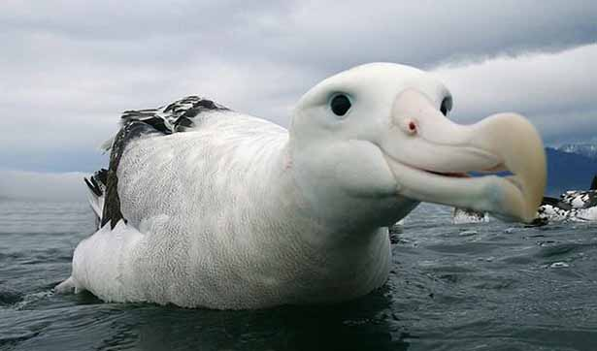
ii: Albatross:-
In size it is look like a combination of gull, pelican and parrot.
It is one of the most gorgeous tropical bird you’ll ever see, it is a both rainforest and seabird that depend on fishes for food.
Has a dark grey shade on the face and head side and light grey feathers with white spots at the bottom.
They are surprisingly one of those rare birds that live to long age, and still declared endangered.

Slide 13
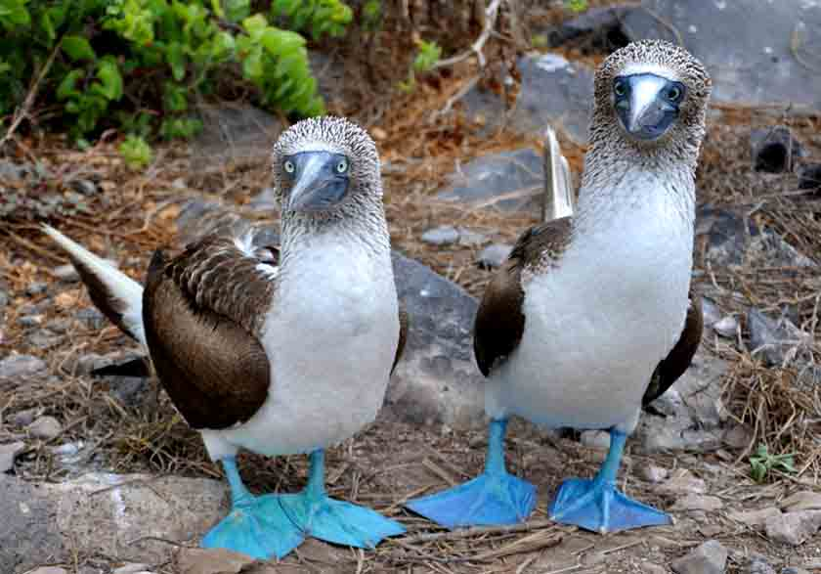
iii:Booby:-
This is one of those tropical birds that can swim, fly and swoop to hunt for food.
It’s a sea bird that quite a large bird and can be as big as pelicans.
The bird has a long beak that helps it catch fishes easily, with a smooth plumage, wide and long wings, and duck foot pigmentation.
Its blue color foot also indicate the current health condition of a booby.

Slide 14
Flight & Flightless Birds
BY LAMIAH MANSOOR

Slide 15
Introduction:-
There are two types of birds.
i: flying birds
ii: non flying birds.

Slide 16
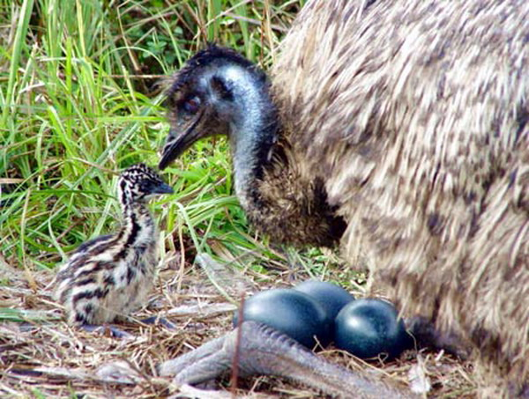
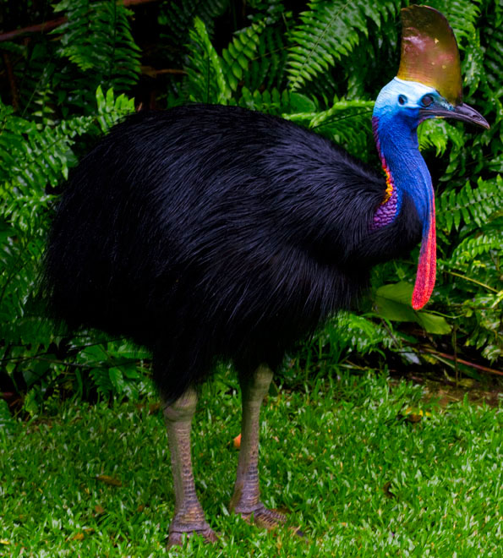
Non-Flying Birds:-
Flightless birds are birds that have evolved the inability to fly.
There are over 40 extant species including the well known ratites, ostrich, emu, cassowary, rhea and kiwi etc.
The smallest flightless bird is the inaccessible Island rail (length 12.5 cm, weight 34.7 g), the largest ( both heaviest and tallest ) flightless bird, which is also the largest living bird, is the ostrich ( 2.7m , 156 kg), ostriches are farmed for their decorative feathers, meat and their skins, which are used to make leather.
Flightless has evolved in many different birds independently, they were also other families of flightless birds, such as the now extent pho Orchid, that evolved to be powerful predators.

Slide 17
SOME FLIHTLESS BIRDS ARE DANGEROUS:
Southern cassowary can tear holes in your body
Like swiss cheese there are have been an upwards
Of around 200 attacks reported per year many of humans
Aren’t getting the hint
Life expectancy
Ostrich: the life expectancy is about 40 to 45 year
Emu: the life expectancy is about 10 to 20 year
Southern cassowary: the life expectancy is about 30 years

Slide 18
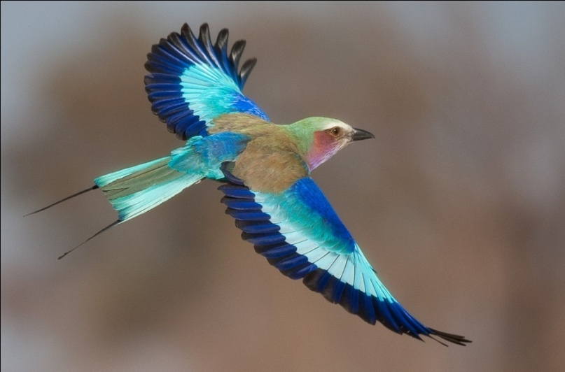
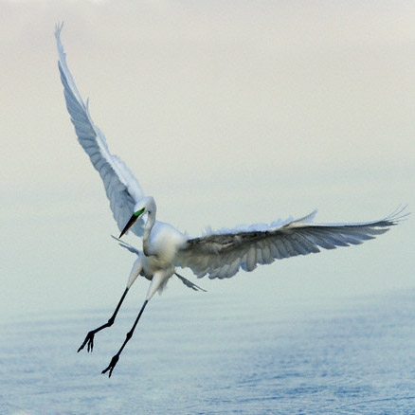
Flying Birds:-
Flying birds have warm bodies.
The body temperature of flying birds is generally higher than that of humans, so they seem warm to the touch.
They live in woodlands, open areas, cities, lakes, swamps even the open oceans.
They lay their eggs and raise their young's in holes in the ground, in nest of varying complexity in vegetation or on the ground, in holes in trees, in human constructed nest boxes, and in or on various parts of buildings.

Slide 19
Comparison Between Flying & Non-Flying Birds:-
Flightless Birds ( ratitae
Flying Birds ( carinatae )
i: They are usually large in size.
ii: They have poorly developed wings.
iii: Tail quills are absent.
iv: Oil gland is absent.
v: Reduced flight muscle.
vi: They have discontinuous distribution.
i:They are usually small in size.
ii:They have well developed wings.
iii: Tail quills are present.
iv: Oil gland is present.
v: well developed flight muscles.
vi: They have cosmopolitan distribution ( found everywhere ).

Slide 20
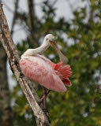
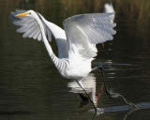
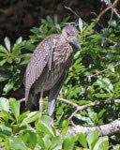
Flying Birds:-
Great Egret.
Roseate spoonbill.
Yellow crowned night heron

Slide 21
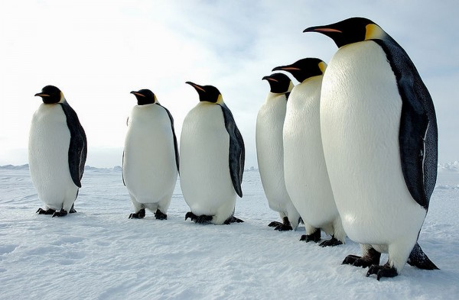
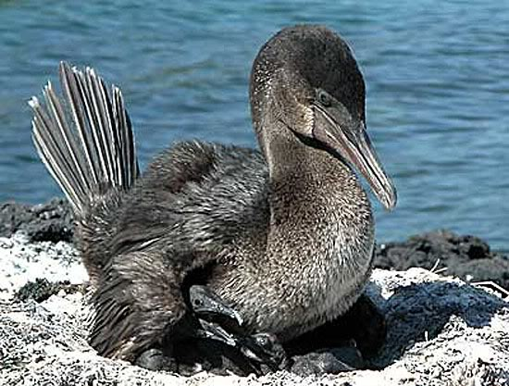
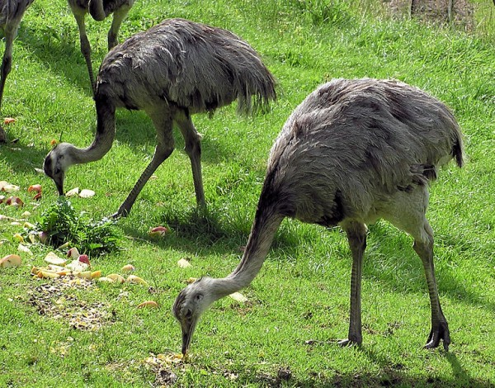
Non-Flying Birds:-
Emperor Penguins.
Flightless cormorant.
Great Rhea.

Slide 22
Types Of Birds
BY ALINA AMJAD ALI

Slide 23
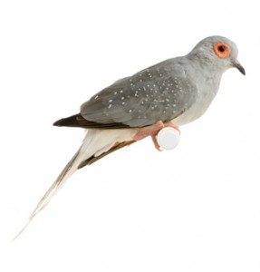
i: Pet Birds:-
Diamond Dove:
The diamond bird is a tiny, delicate-looking bird whose body is about a size of a lovebird, but with a long, slender tail.
The color of these birds are often found in nature, is a darkish-grey with specks on the wings.
The diamond is native to Australia, where they are found in the dry deserts in the north & the central parts of Australia.
Doves are not generally loud birds.

Slide 24
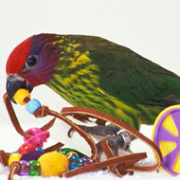
Goldie's Lorikeets
The life expectancy is about 20 years
The lorikeets are native to New Guinea, and their noise level is low.
Goldie's lorikeets are susceptible to hemi chromatists or iron-storage disease.
They need nectar as the base of their diet.
The Goldie's lorikeet is very curious, so they supervise playtime and be sure their cage bars have appropriate spacing

Slide 25
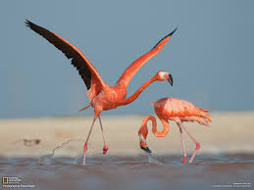
ii: Wild Birds:-
Flamingos:
These famous pink birds can be found in warm, watery regions on many continents.
The flamingos are surprisingly fluid swimmers, but really thrive on the extensive mud flats where they breed and feed.
Their bent bills allow them to feed on small organisms- planktons, tiny fish, fly larvae etc.
A flamingo’s beak has a filter like structure to remove food from the water before the liquid is expelled.
Greater flamingos live and feed in groups called flocks or colonies.

Slide 26
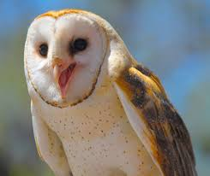
Barn Owl:
The barn owl is the most widely distributed species of owl and one of the most widespread of all birds. Its scientific name is tyro alba. They are ghostly pale and strictly nocturnal. These medium-sized owls have long , rounded wings and short tails. The legs are long and the head is smoothly rounded.

Slide 27
REPRODUCTION IN BIRDS
BY
BEENISH KHAN

Slide 28
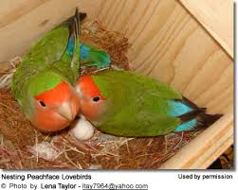
Reproduction In Birds:-
Breeding Season Timing:
Birds do not mate for pleasure, only for procreation, and many male birds are sterile outside the breeding season. The exact timing of when bird pairs comes together for successful mating varies, and the timing evolves for different species to give the resulting chicks the best chance of survival. Factors that affect when birds mate include.
1. Geography:-
The farther north a bird’s breeding range is located, the later its mating season will commence.
These birds may migrate earlier, however, because they have greater distances to travel in order to reach their ideal breeding locations.

Slide 29
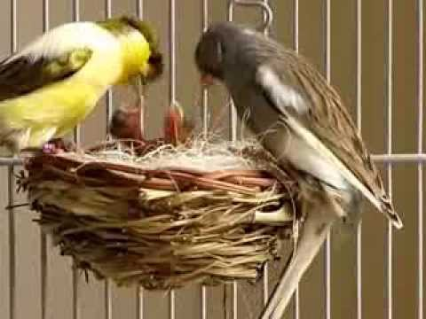
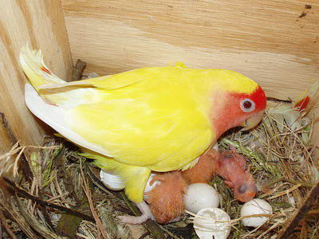
2. Food:-
A greater availability of easily accessible food is essential for parent birds to provide adequate nutrition for their chicks. This is why birds migrate before breeding season, because moving to a different area where food is abundant helps spread out their population so they will have a better chance of properly feeding their young.

Slide 30
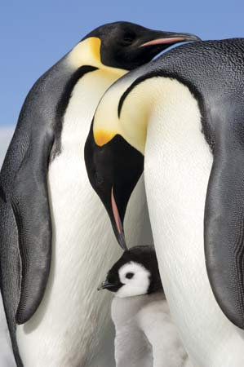
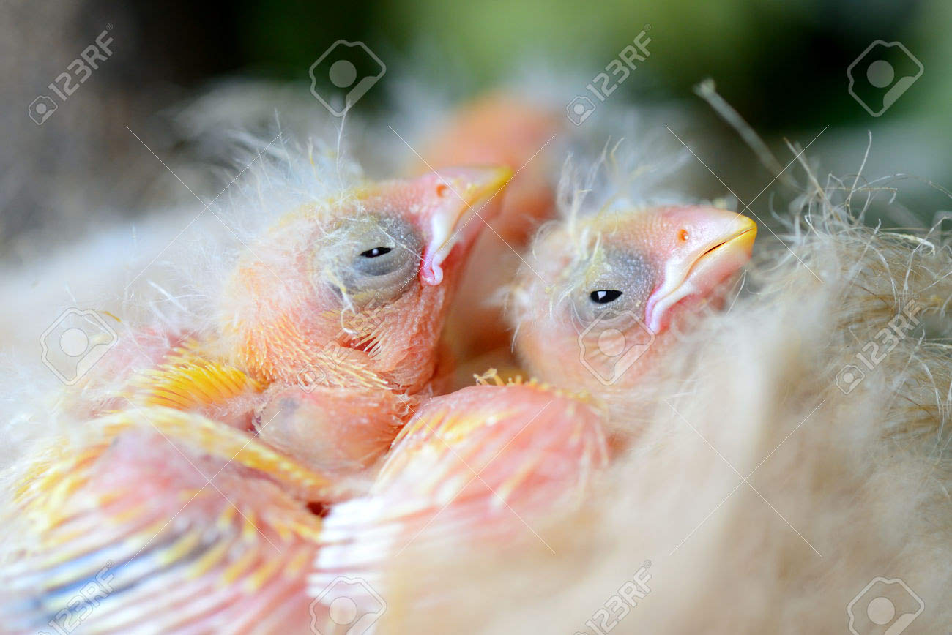
3. Care Period:-
Some baby bird mature quickly while others require their parents care for weeks or months before they can feed and protect themselves.
The more care a baby bird requires or the longer the initial incubation period for the eggs,
the earlier the mating season will be so parents have enough time to raise the chicks before environmental conditions worsen .

Slide 31
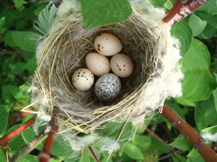
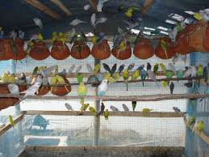
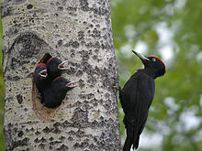
4. Nesting Sites:-
Where a bird builds a nest can affect the time it mates.
Cavity nesting species that reuse the nest cavities of other birds may breed later in the season so more nesting sites have already been abandoned after earlier successful nests.
Birds that build new nests each year may also nest later in the season, while birds that reuse old nests each year can mate earlier and still have a suitable location to raise their young.

Slide 32
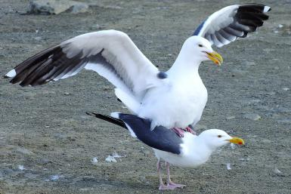
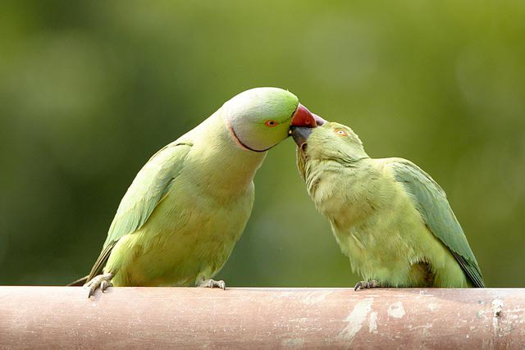
Signs Of The Mating Season:-
Spring is the typical mating season for most bird species because food sources are increasing, melting snows, and spring rains provide plenty of water and there will be a long, temperate season for birds to mature before winter arrives.
Birders can watch for signs of the breeding season, however, to learn when local birds are feeling reproductive urges.
To pinpoint when the bird mating season occurs,
Warming temperature and blooming flowers that show the change of seasons.
Birds claiming territory and becoming more aggressive toward intrudes, particulaly males.
Increased bird songs, which can help definite trritories and attract males.
Bird courtship behaviour, including elaborate display flights and other bonding

Slide 33
Adaptations in birds
by
MEHAK RAFIQ

Slide 34
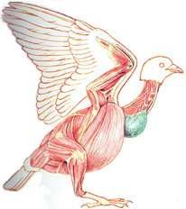
Light but Powerful Musculature
Most birds have approximately 175 different muscles, mainly controlling the wings, skin, and legs.
The largest muscles control the wings and run between the upper arm and the keel.
The pectoralis major provides the powerful downstrokeThe supracoracoideus muscle raises the wing Uses a pulley-like system to lift the wing.
These musclesconstitute about 20 – 25 percent of the bird's total body mass.
Pectoralismajor
Pulls the wing down

Slide 35
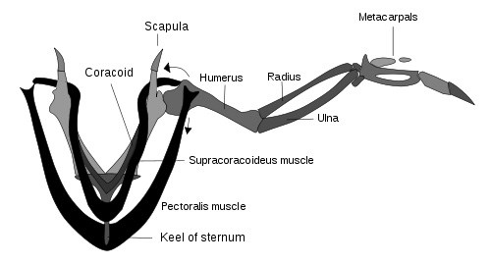
Respiratory System
Due to the high metabolic rate required for flight, birds have a high oxygen demand Birds ventilate their lungs by means of air sacs.
The active phase of respiration in birds is exhalation, requiring muscular contraction . Air flows through the air sac system and lungs.
The active phase of respiration in birds is exhalation, requiring muscular contraction . Air flows through the air sac system and lungs.
The partial pressure of oxygen in a bird's lungs is the same as the environment
Birds have more efficient gas-exchange of both oxygen and carbon dioxide than do mammals.

Slide 36
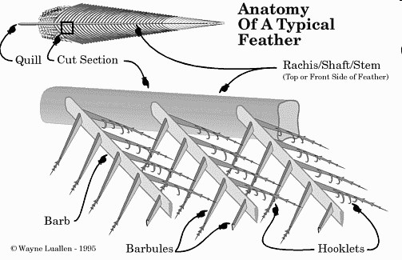
Feathers
The organisms on earth, only birds have feathers
They are instrumental in flying.
They play a critical role in temperature regulation.
Their color patterns are essential in both display and camouflage.
The mass of feathers on a bird’s body constitutes its plumage
Feathers clump in distinct tracts with featherless areas in between
Birds’ color patterns are built of these units Worn feathers are periodically replaced through a process called “molt”

Slide 37
THANK YOU !!!

Slide 38
ANY QUESTION ???????

